Slide 1

Experiment 3: Weather Monitoring
Navarro, Rod Geryk C.
CPE161P-4– C1

Slide 2
OBJECTIVES
1. To demonstrate how a weather monitoring system works in real-time.
2. To be able apply what you have learned in logic circuits and switching theory, microprocessors, and CPE160P.
3. To be able to apply real-time embedded system using arduino kit.

Slide 3
MATERIALS
Arduino Kit
LCD (16x2)
DHT11 Sensor
Laptop

Slide 4
PROCEDURE
Create a working real-time weather monitoring system using Arduino.
To demonstrate the usage of LCD, and temperature sensor (DHT11).
Debug the code

Slide 5
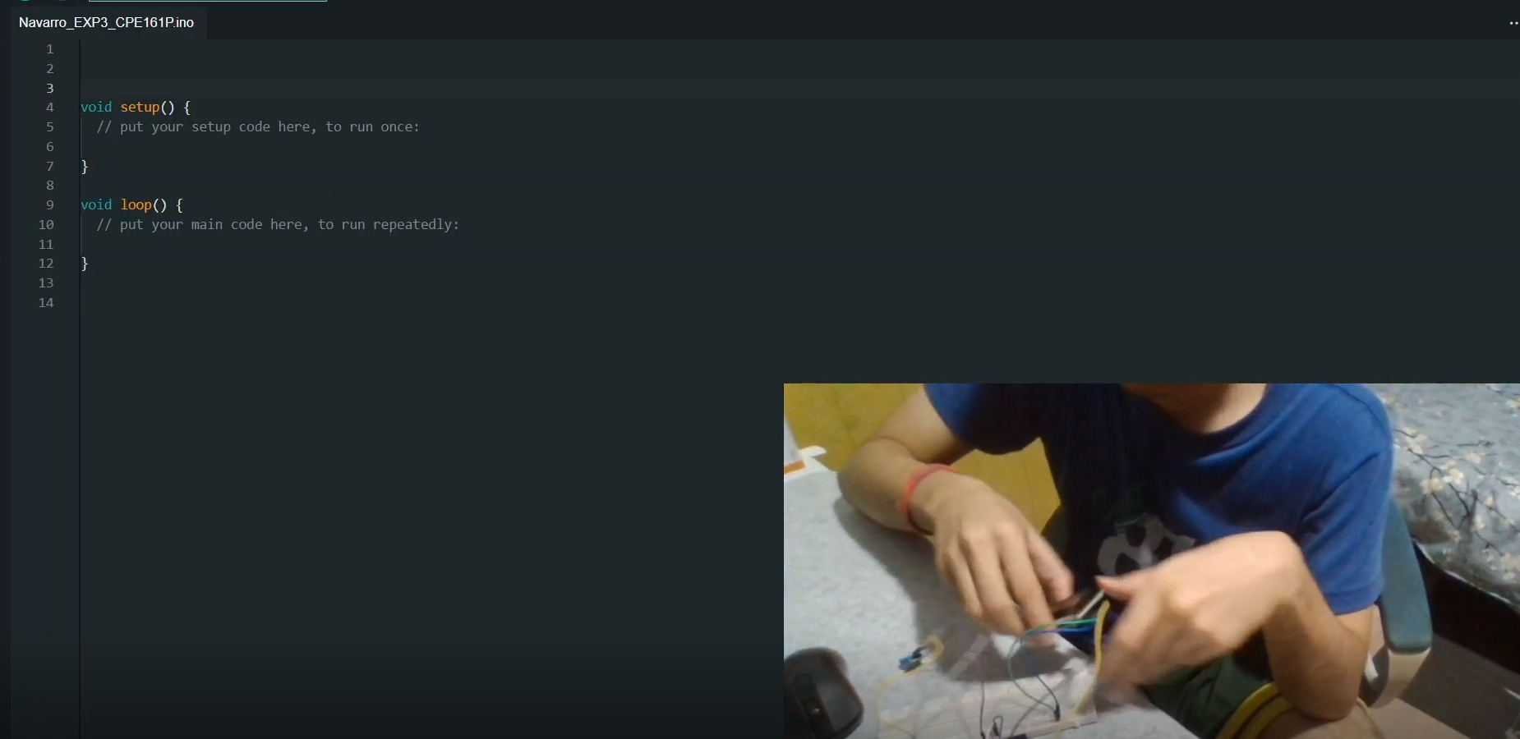
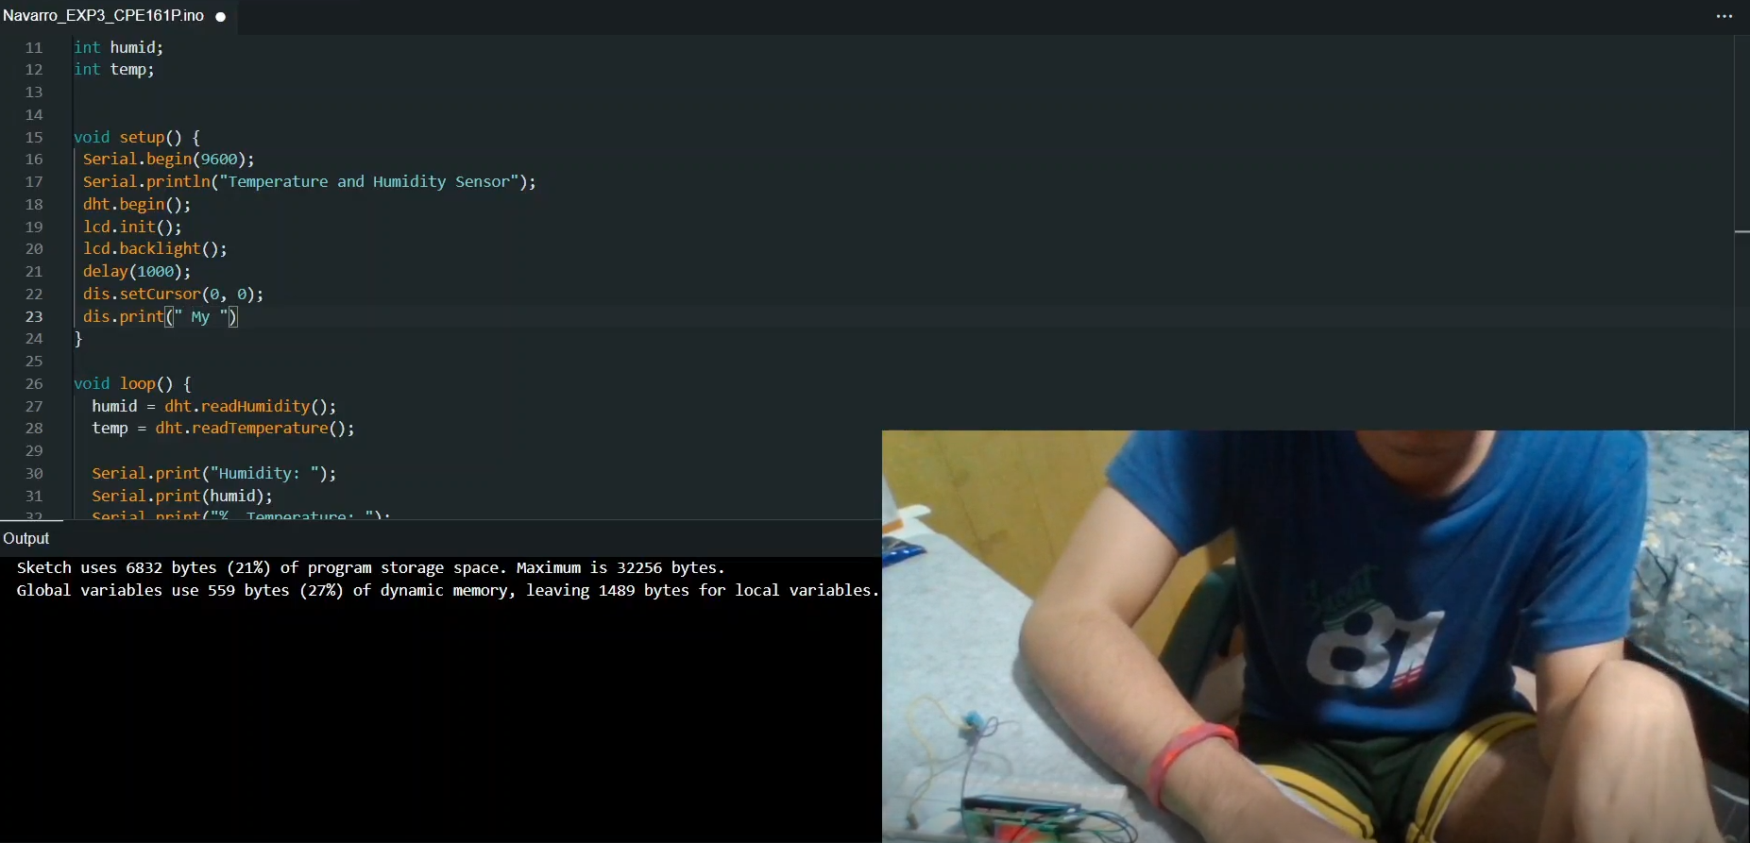
PROCEDURE

Slide 6
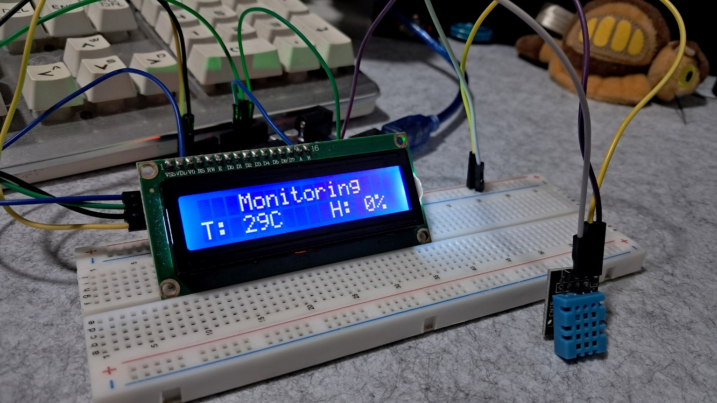
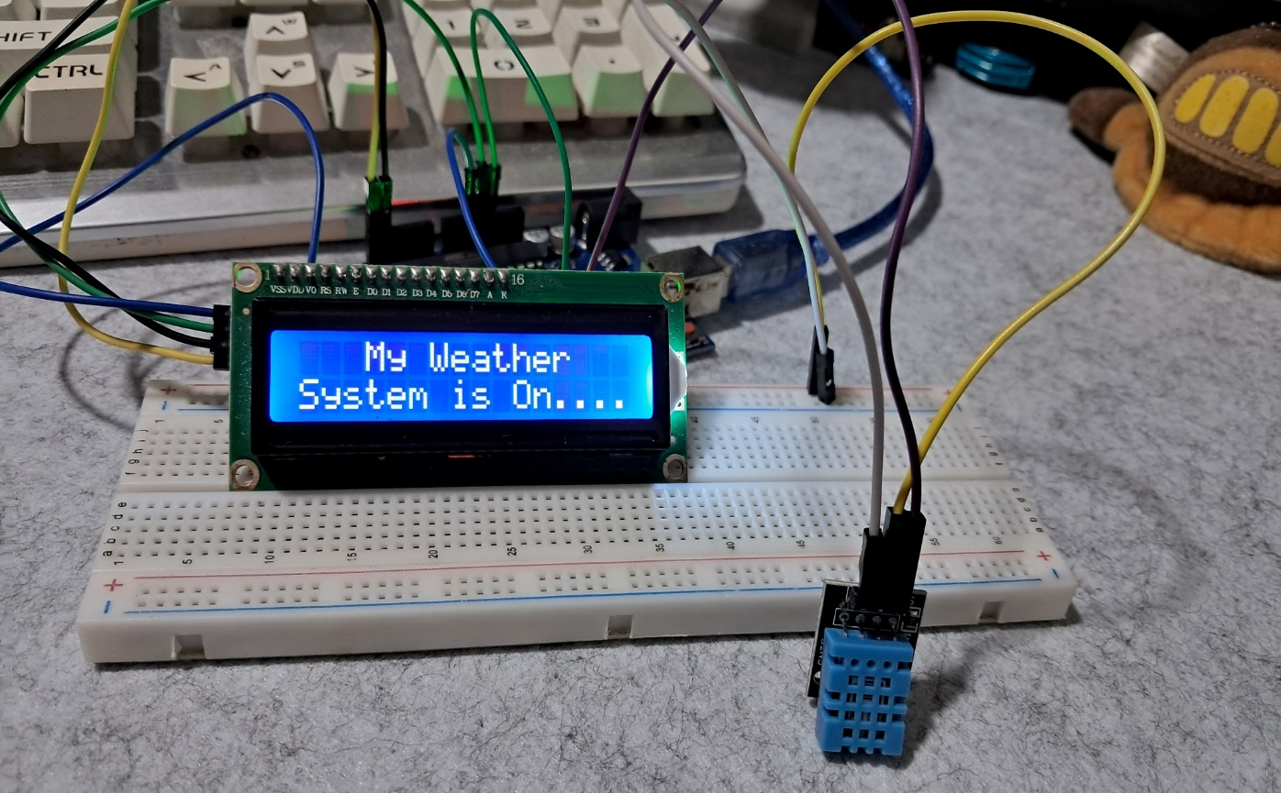
Final Output

Slide 7
THANK YOU!

